Slide 1

Saliency Maps
João Vítor C. Pessoa, Breno de Lima Galves
Universidade Federal do Rio de Janeiro (UFRJ)

Slide 2

CONTENT
01
INTRODUCTION
02
DEFINITION
03
TYPES OF SALIENCY MAPS
04
DEMO
05
EXPERIMENT
06
RESULTS
2

Slide 3
INTRODUCTION
“One thing that connectionist networks have in common with brains is that if you open them up and peer inside, all you can see is a big pile of goo.”
- Mozer & Smolensky, 1989
3
3

Slide 4
INTRODUCTION

Slide 5





DEFINITION
A saliency map is a visualization technique that highlights the pixels in an image that are most influential for a neural network’s classification decision for a specific class
Saliency maps answer the question:
Which pixels does the network focus on when making its suggestion?"
Cat.
That’s everything! Except a cat.
4
3
3

Slide 6
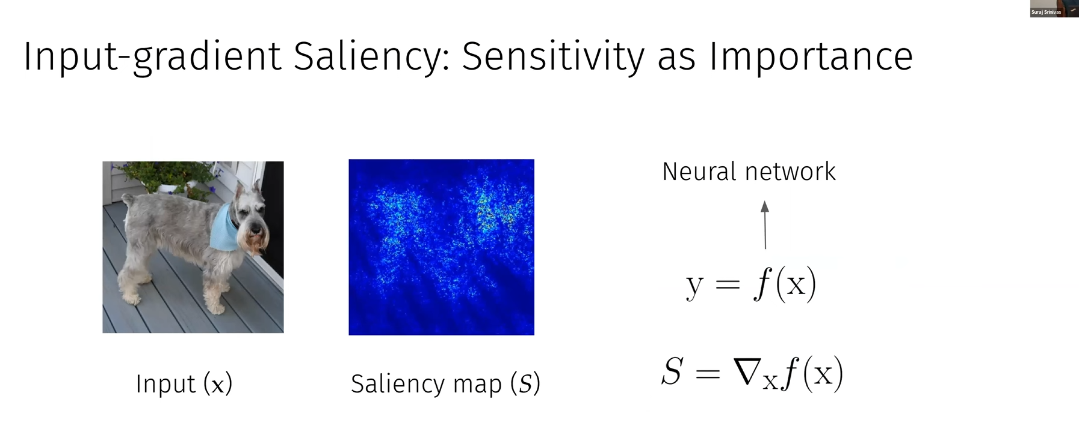
DEFINITION
6

Slide 7

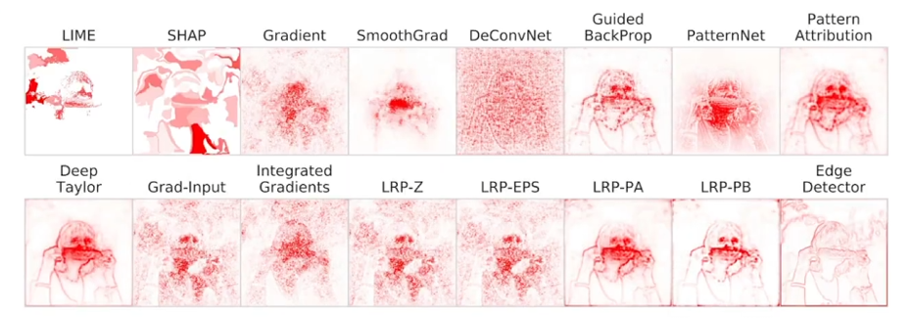
TYPES OF SALIENCY MAPS
Corn
4

Slide 8


TYPES OF SALIENCY MAPS
Dog
Gradient
Perturbation direction of fastest ascent for the class logit
5

Slide 9
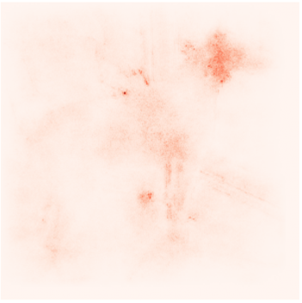
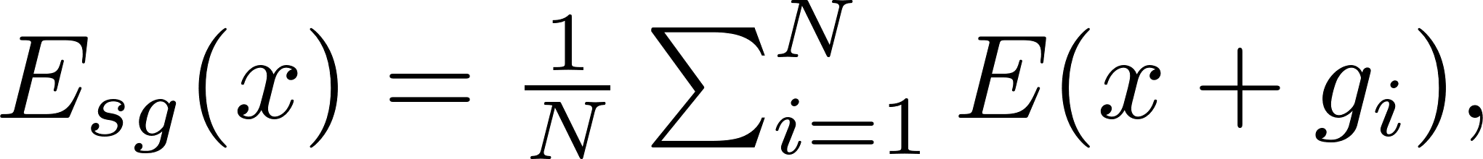
TYPES OF SALIENCY MAPS
Dog
SmoothGrad
Average saliency using inputs with Gaussian noise
6

Slide 10
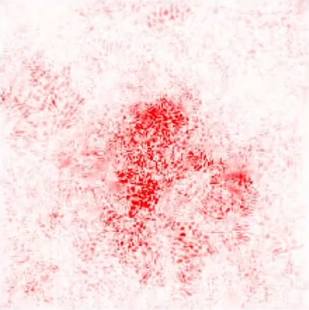
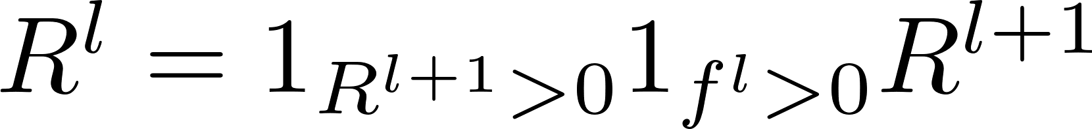
TYPES OF SALIENCY MAPS
Dog
Guided BackProp
Backprop with intermediate negative activations and gradients zeroed out
7

Slide 11
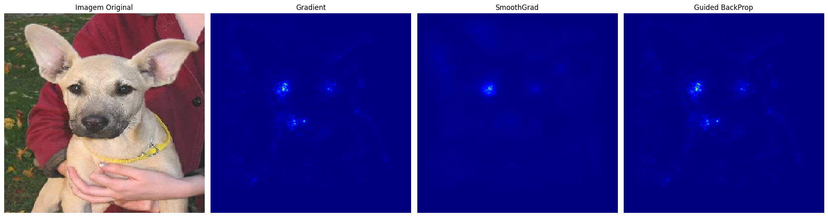
DEMO
Original
Gradient
SmoothGrad
Guided Backprop
7

